Slide 1






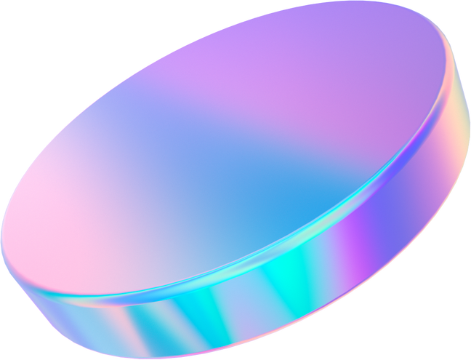
Micro Intel
Presentation

Slide 2
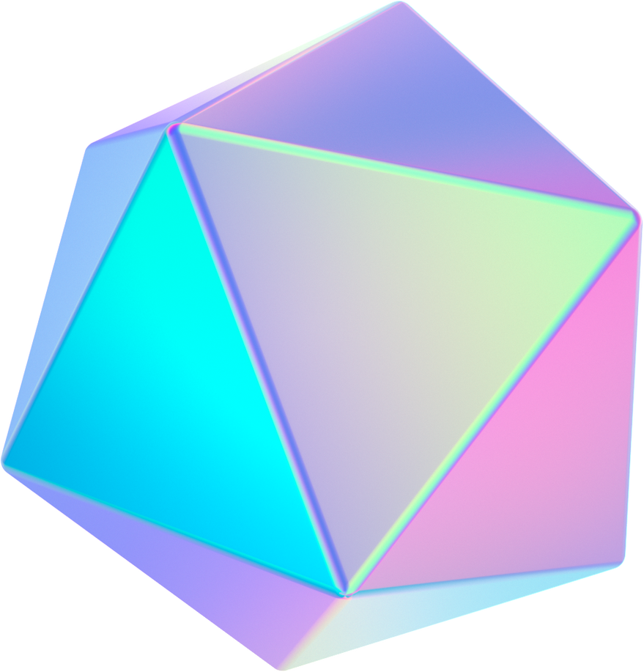


Tech Company
We build software that empowers organizations to effectively integrate their data, decisions, and operations.

Slide 3
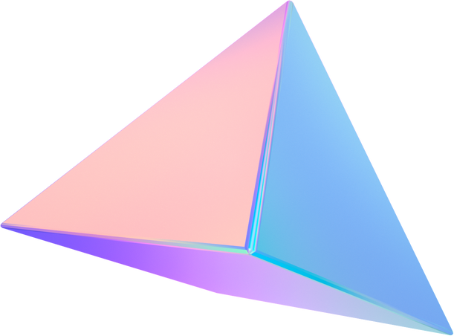

About Us
We've advanced beyond incremental efficiencies to bring intelligence to the core of everything that matters most to your work.

Slide 4





Team
AMITH
DHANUSH
NIKHIL
VIGNESH
Designer
Tester
Coder
Coder
Design is the Marvel magic, transforming ideas into extraordinary visuals. Every detail is a marvel, creating a world where imagination comes to life.
Testing is the Marvel touch in software, turning codes into reliable stories. Each test is a marvel, ensuring a digital world where functionality meets perfection.
Being a coder is like having a Marvel toolkit for the digital world, turning concepts into tech marvels. Every line of code is a superhero move, creating a virtual universe of endless possibilities.
Being a coder is like having a Marvel superpower for technology, turning concepts into digital marvels. Every code is a superhero move, shaping a tech universe of endless possibilities.

Slide 5


Market Overview
0.9%
$0.01 Billion
1.0%
Market Growth Rate
Market Size
Growth for 2023

Slide 6
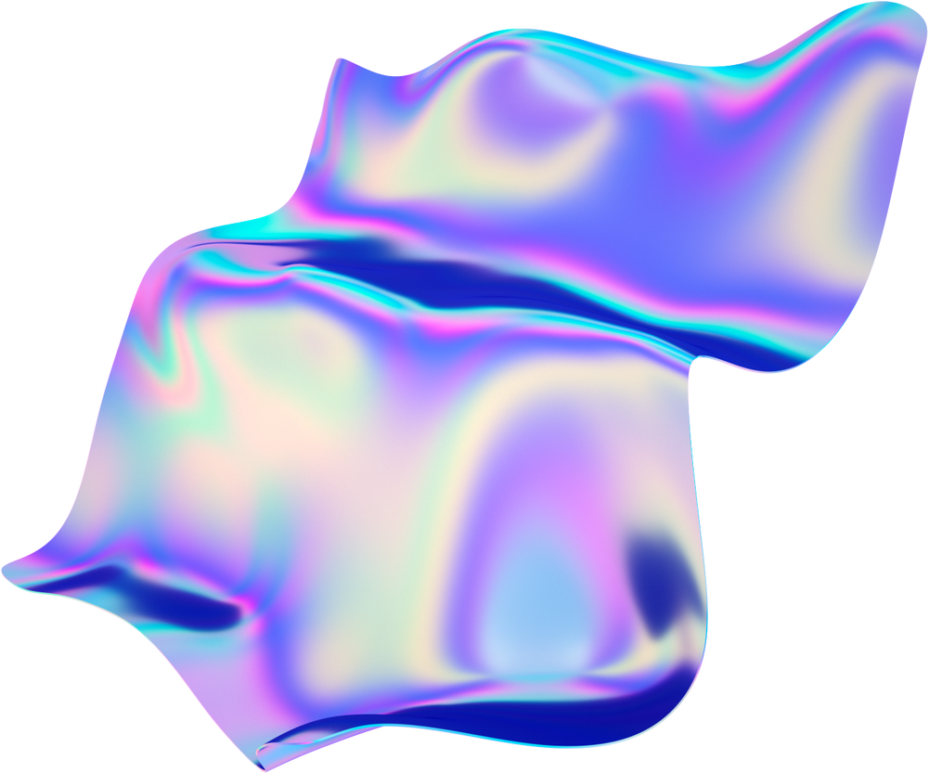

Roadmap
Q1
Q2
Q3
Idea Generation
Market Research
Concept
Brand Survey
Brand Awareness & Marketing
Component Research
Cost Analysis
Testing functions
Apps interaction
Product Handling
Launch

Slide 7
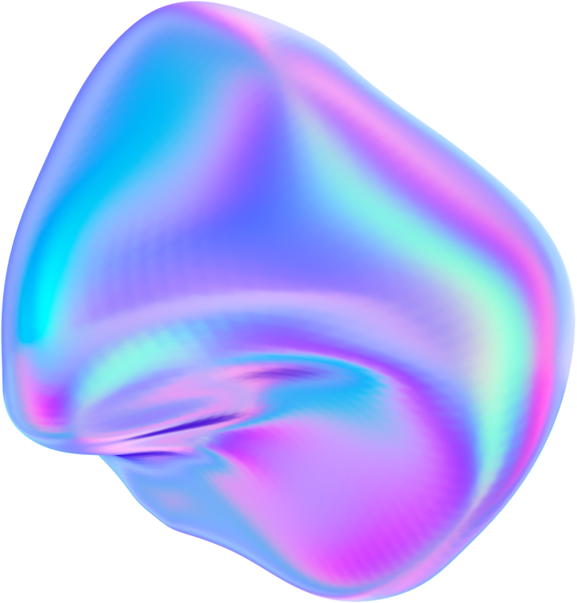


Top Products
MICRO - DISK
MICRO - GRAPHY
MICROINJECTION
MICRO - SEARCH
MICRO - LEARN
Product 3
MICRO - RESULT
MICRO - CHAT

Slide 8
What we do
We make products for human-driven analysis of real-world data
We build our company around mission-driven engineering
We meet the problems where they live
We design technology to help institutions protect liberty

Slide 9
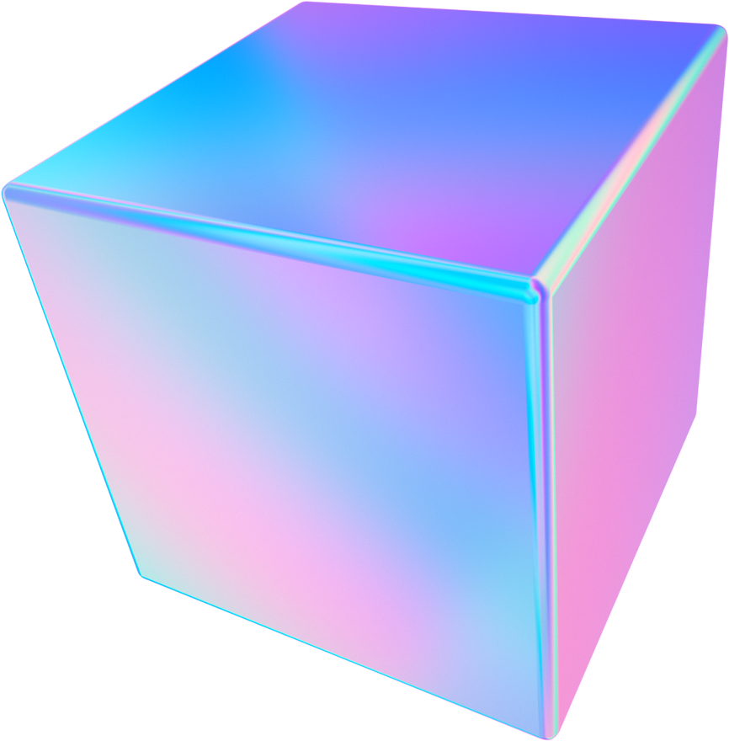
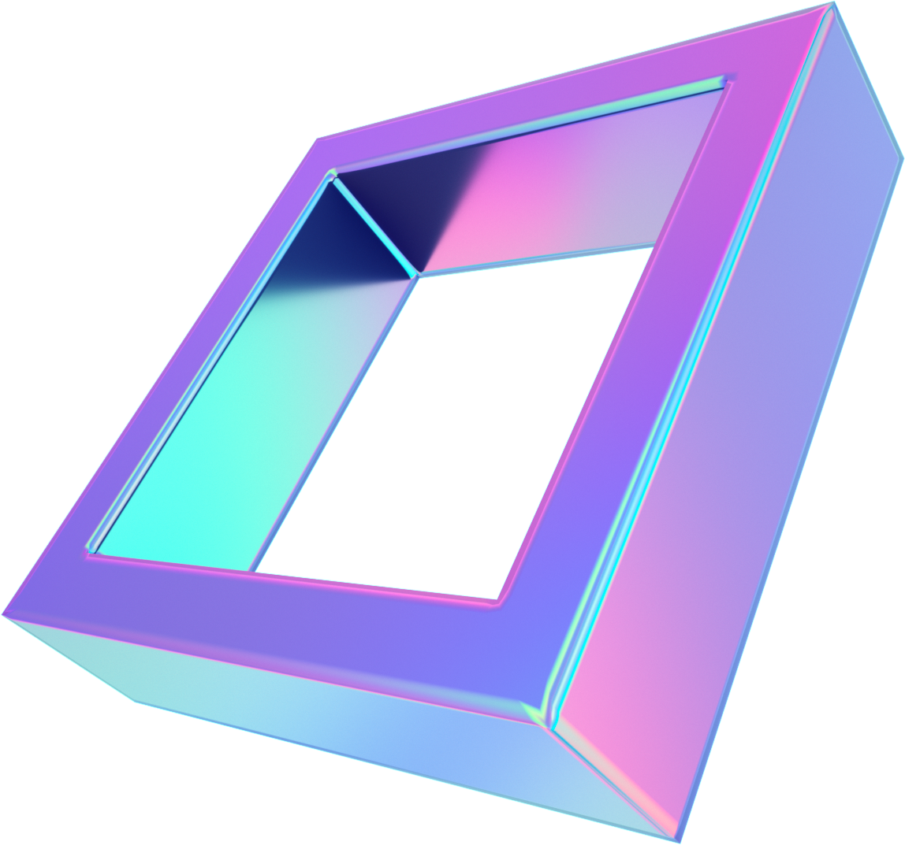
With good data and the right technology, people and institutions today can still solve hard problems and change the world for the better.

Slide 10
@micro_intel
Thank You
microfly2410@gmail.com
www.microintel.000.pe
MicroIntel Tech 789 Innovation Street, Byte, TX 56789

